Slide 1

Exercise 1 Activity

Slide 2
Good temporal coverage
Good spatial coverage
Survey targets the appropriate habitat
Annual variability in index is high
Poor temporal coverage
Poor spatial coverage
Optimal survey timing
Survey does not target the appropriate habitat
Index is not proportional
to abundance
Copy text boxes and paste in Table below as many times as needed. Add other pros/cons if you want
Landings | CPUE for purse seine fleet | Relative index of total (benthic) biomass from groundfish bottom trawl survey | Relative index of SSB from acoustic surveys on the spawning grounds
Pros
Cons

Slide 3
Exercise 1
Choose Entire Stock or MU1
Q1
Spatial Area:
Pros
Cons
Q2
Preferred indicator: | e.g. acoustic index of SSB or bottom trawl biomass index
Pros
Cons
Q3
Rational for choice. Any candidate best practice criteria?

Slide 4
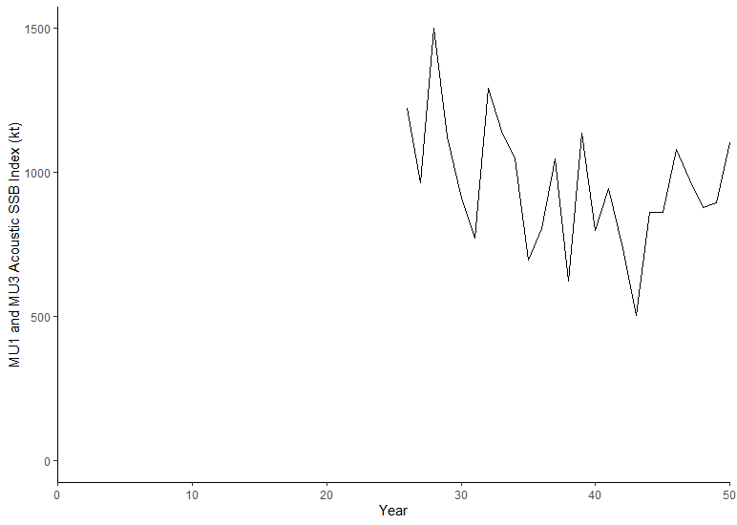
Exercise 1
Q4
Add plot here from R
Q5
Performance Metric
P(Indicator > LRP) > probability after X years
Q6
How should stock be prescribed? Entire stock area or MU1
Q7
Assumptions needed to select a single LRP for the stock

Slide 5
Exercise 1 Presentation Slide (to share at the workshop tomorrow)

Slide 6
Break Out Group Add Number
Spatial Area:
Indicator:
LRP:
Rationale:
Add plot here
Submit to Tim.Barrett@dfo.mpo.gc.ca when complete

Slide 7
Submit to tim.barrett@dfo.mpo.gc.ca when complete

